Slide 1
EE 422C
Socket Programming

Slide 2
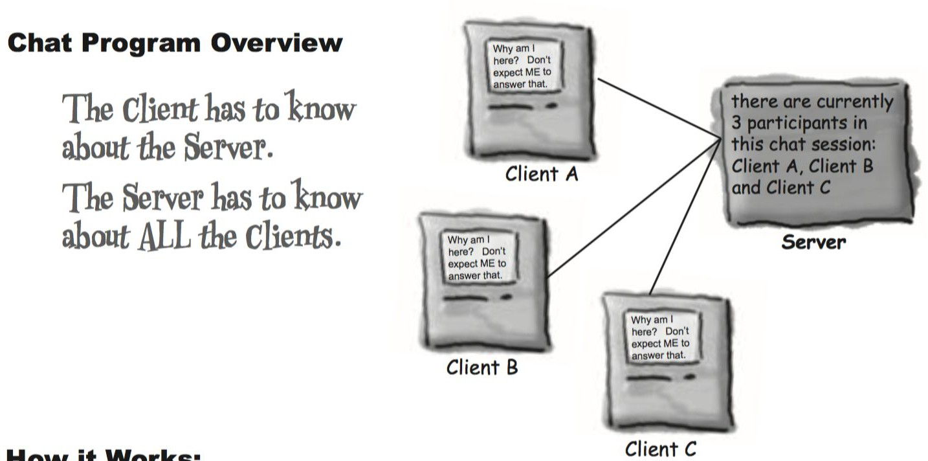
Scenario: Chat Program
-

Slide 3
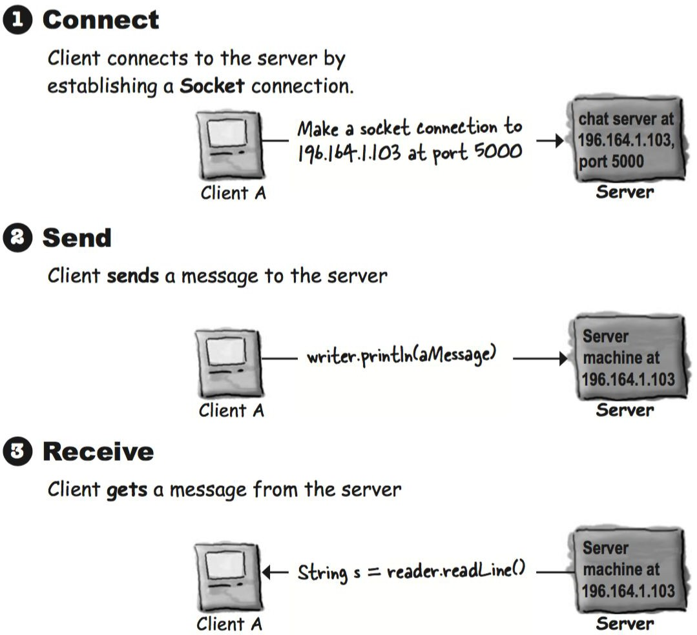
Network Connection - Overview

Slide 4
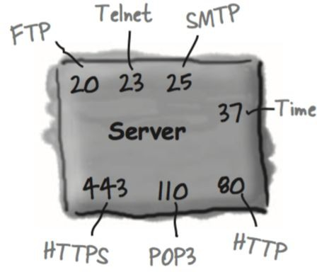
Socket Programming - Concept
Socket ( java.net.Socket class) is an object that represents a network connection between two machines.
Client wants to make a Socket connection
who it is (Server’s IP address), and
which service (Server’s port number).
3. Port number is a 16-bit number that identifies a specific program on the server. The port numbers from 0 to 1023 are reserved for well-known services, pick your port number from 1024 to 65535.

Slide 5
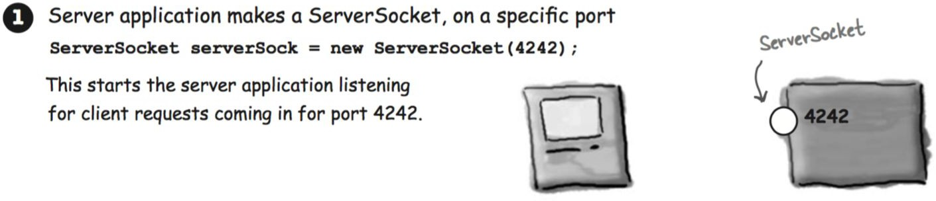
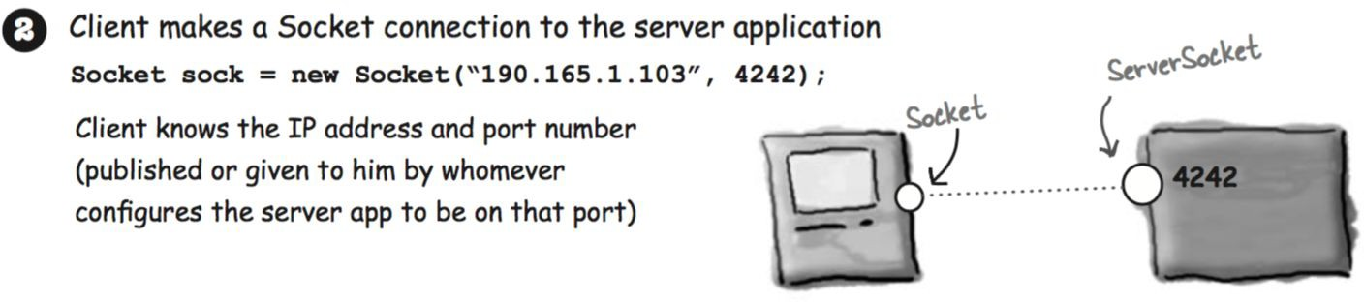
Socket Programming - Connect

Slide 6
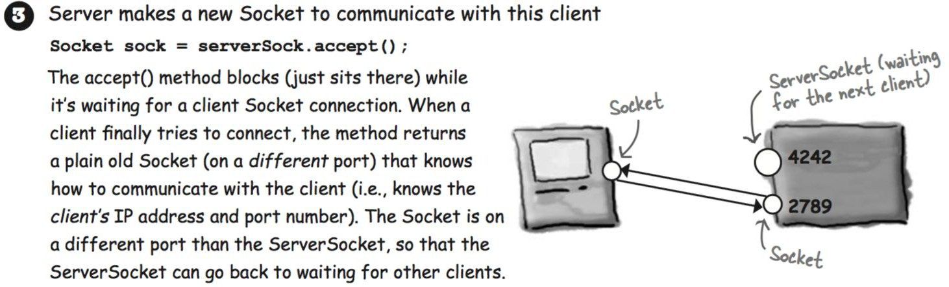


Socket Programming - Connect (cont.)
ServerSocket serverSock = new ServerSocket(4242); while(true) {
Socket clientSocket = serverSock.accept();
Thread t = new Thread(new ClientHandler(clientSocket)); t.start();
System.out.println("got a connection");
}
Server
Socket clientSock = new Socket(“190.165.1.103”,4242);
Client

Slide 7
Socket Programming - Send

Slide 8
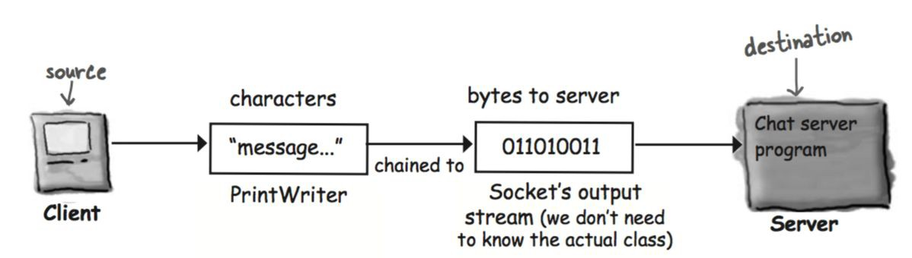
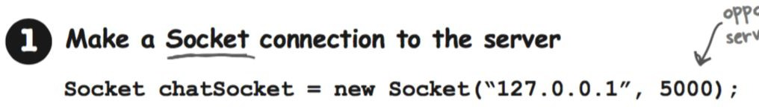
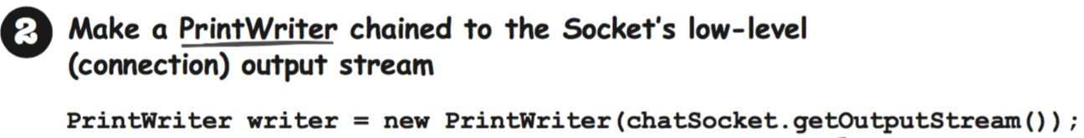
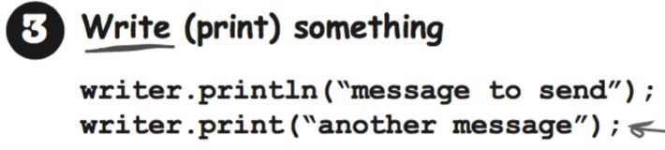
Socket Programming - Send

Slide 9
Socket Programming - Receive

Slide 10
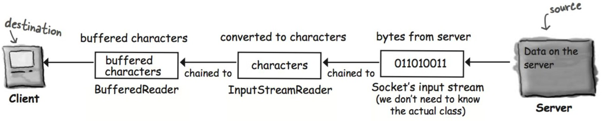
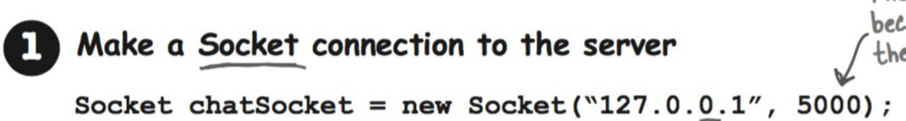
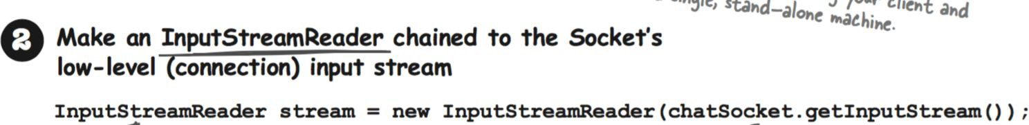
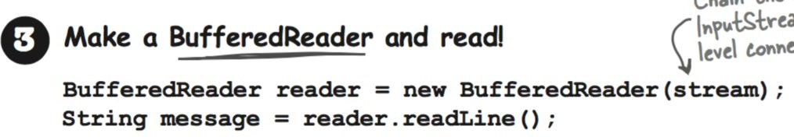
Socket Programming - Receive

Slide 11
Socket Programming - iClicker (2)
How does a client know the host’s IP address when requesting a socket connection?
By querying the host directly
By looking up the host’s IP address in some database, like a DNS, or some means outside the program.
Other

Slide 12
Socket Programming - Example
Example: Chat Server and Chat Client

Slide 13
Example - Client
public class ChatClient {
private BufferedReader reader; private PrintWriter writer; private JTextArea incoming; private JTextField outgoing;
...
private void setUpNetworking() throws Exception { Socket sock = new Socket("127.0.0.1", 5000);
InputStreamReader streamReader = new InputStreamReader(sock.getInputStream()); reader = new BufferedReader(streamReader);
writer = new PrintWriter(sock.getOutputStream()); Thread readerThread = new Thread(new IncomingReader()); readerThread.start();
}
}
class IncomingReader implements Runnable { public void run() {
String message;
while ((message = reader.readLine()) != null) { incoming.append(message + "\n");
}}

Slide 14
Example - Server
public class ChatServer {
private ArrayList<PrintWriter> clientOutputStreams;
private void setUpNetworking() throws Exception { clientOutputStreams = new ArrayList<PrintWriter>();
ServerSocket serverSock = new ServerSocket(5000); while (true) {
Socket clientSocket = serverSock.accept();
PrintWriter writer = new PrintWriter(clientSocket.getOutputStream()); Thread t = new Thread(new ClientHandler(clientSocket));
t.start(); clientOutputStreams.add(writer); System.out.println("got a connection");
}
}

Slide 15
Example - Server (Cont.)
class ClientHandler implements Runnable { private BufferedReader reader;
public ClientHandler(Socket clientSocket) throws IOException { Socket sock = clientSocket;
reader = new BufferedReader(new InputStreamReader(sock.getInputStream()));
}
public void run() { String message;
while ((message = reader.readLine()) != null) { notifyClients(message);
}
}
}
private void notifyClients(String message) {
for (PrintWriter writer : clientOutputStreams) { writer.println(message);
writer.flush();
}
}
17

Slide 16
Example - Client (Cont.)
public class ChatClient {
...
private void initView() {
...
outgoing = new JTextField(20);
JButton sendButton = new JButton("Send"); sendButton.addActionListener(new SendButtonListener());
class SendButtonListener implements ActionListener { public void actionPerformed(ActionEvent ev) {
writer.println(outgoing.getText()); writer.flush();
}
}

Slide 17
Example - Chat Program
Demo: Chat Server and Chat Client

Slide 18
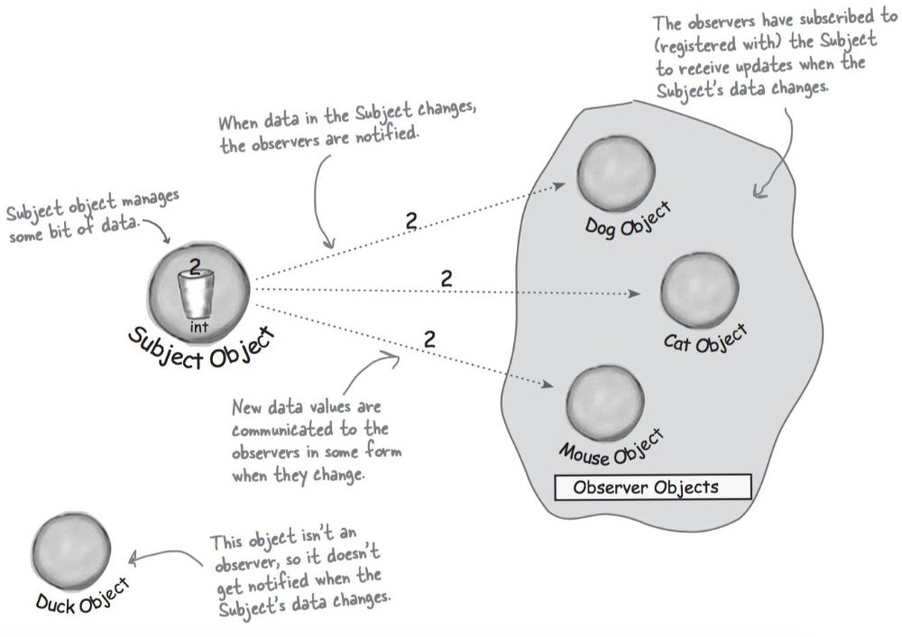
Recall: Observer Design Pattern

Slide 19
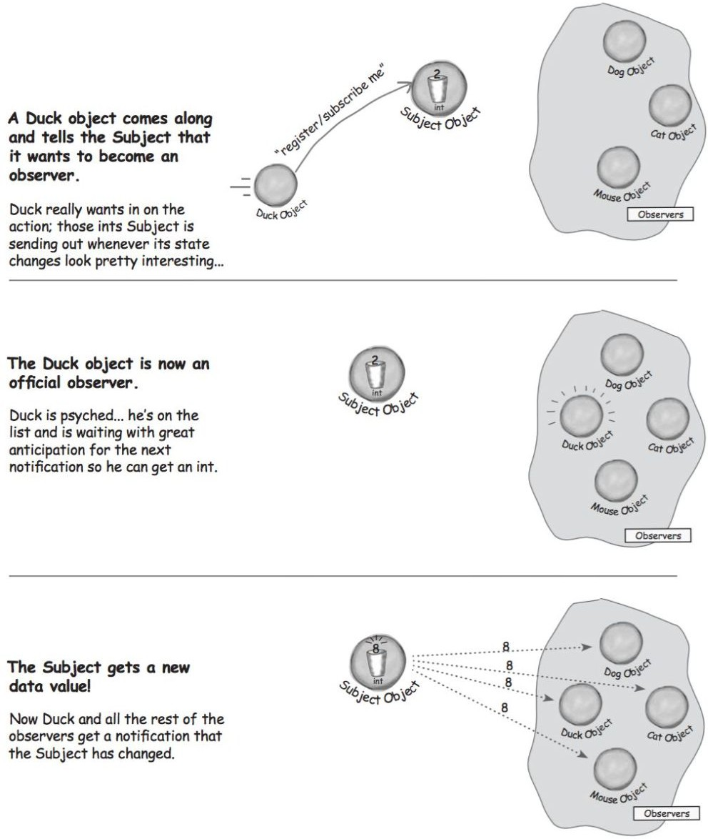
Observer Design Pattern

Slide 20
Example - Chat Program
Demo: Chat Program with Observer Design Pattern

Slide 21
Socket Programming - Summary

